Slide 1



A CENTER FOR INTER-DISCIPLINARY RESEARCH
2020-21
TITLE
“A FINE WINDY DAY”
PREDICTION OF POWER GENERATED BY WIND TURBINES
SUPERVISED BY
MOHAMMED YASEEN ALI
DEVI HEMA
GOKARAJU RANGARAJU
INSTITUTE OF ENGINEERING AND TECHNOLOGY
AUTONOMOUS

Slide 2
Advanced Academic Center
( A Center For Inter-Disciplinary Research )
This is to certify that the project titled
“ A FINE WINDY DAY”
is a bonafide work carried out by the following students in partial fulfilment of the requirements for Advanced Academic Center intern, submitted to the chair, AAC during the academic year 2020-21.
NAME | ROLL NO. | BRANCH
MARIA JABEEN | 20241A0593 | CSE
VANAPATLA ROHITH REDDY | 20241A12H8 | IT
CHIDRALA SANJANA | 20241A6710 | CSE-DS

Slide 3
NAME | ROLL N0 | BRANCH
M HEMANTH SAI | 20241A04F1 | ECE
LALITESHWAR | 20241A0526 | CSE
This work was not submitted or published earlier for any study
Dr/Ms./Mr.
Dr.B.R.K.Reddy
Program Coordinator
Dr.Ramamurthy Suri
Associate Dean,AAC
Project Supervisor

Slide 4
ACKNOWLEDGEMENTS
We express our deep sense of gratitude to our respected Director, Gokaraju Rangaraju Institute of Engineering and Technology, for the valuable guidance and for permitting us to carry out this project.
With immense pleasure, we extend our appreciation to our respected Principal, for permitting us to carry out this project.
We are thankful to the Associate Dean, Advanced Academic Centre, for providing us an appropriate environment required for the project completion.
We are grateful to our project supervisor who spared valuable time to influence us with their novel insights.
We are indebted to all the above mentioned people without whom we would not have concluded the project.

Slide 5
A FINE WINDY DAY
PREDICTION OF POWER GENERATED BY WIND TURBINES

Slide 6
ABSTRACT:
In this project, we were asked to experiment with a real-world dataset, and to explore how machine learning algorithms can be used to find the patterns in data. We were expected to build a sophisticated Machine Learning model that predicts the power that is generated (in KW/h) based on the various features provided in the dataset.

Slide 7
INTRODUCTION:
Switching to renewable energy sources is a great way to reduce dependency on imported fuels and increase cost efficiency. It is time we move towards a low-carbon future by embracing solar, hydro, geothermal energy and so on, to protect mother nature . An efficient energy source that has been gaining popularity around the world is wind turbines. Wind turbines generate power by capturing the kinetic energy of the wind. Factors such as temperature, wind direction, turbine status, weather, blade length, and so on influence the amount of power generated.

Slide 8
Algorithm:
Extreme Gradient Boosting Algorithm(XGBOOST)
Gradient boosting refers to a class of ensemble machine learning algorithms that can be used for classification or regression predictive modelling problems . Ensembles are constructed from decision tree models. Trees are added one at a time to the ensemble and fit to correct the prediction errors made by prior models. This is a type of ensemble machine learning model referred to as boosting . Models are fit using any arbitrary differentiable loss function and gradient descent optimization algorithm. This gives the technique its name, “gradient boosting,” as the loss gradient is minimized as the model is fit, much like a neural network.

Slide 9
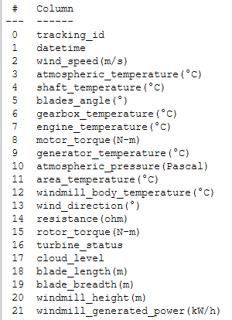
Project Overflow:
The dataset of the project is taken from the kaggle website. There are two datasets ,train dataset on which the model is build and algorithm is applied and the test dataset for which the power generated by the windmill is to be predicted.
Data Exploration and Analysis:
Preprocessing the train dataset:
The train dataset has the following 22 features.
Out of 22 features 19 features(excluding datetime ,
tracking_id , atmospheric pressure(Pascal) columns)
are used to build the predictive model.

Slide 10
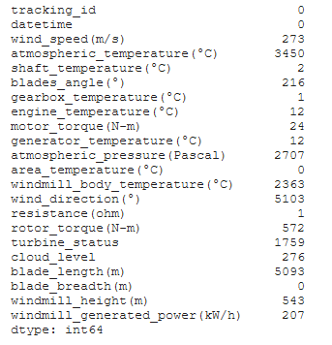
Handling Null Values:
The train dataset has null values in the columns . The number of null values
is given below.
There are two types of null values.
Numerical null values.
Categorical null values.
Numerical null value of a specific
column are replaced with the mean
of that specific column.
Categorical null value of a specific
column are replaced with the mode
value of that specific column.

Slide 11
Feature Engineering:
Since the algorithm requires numeric dataframe only, the columns of object type (i.e.,cloud_level,turbine_status columns) has been changed to numeric by applying dummies to the unique values of those columns.
This has increased the number of columns from 22 columns to 37 columns.
The tracking_id and datetime column in the dataset are dropped since it
has no effect while building the model.
The atmospheric_temperature(°C) column has the lowest correlation the windmill_generated_power(kW/h) column so it is dropped.

Slide 12
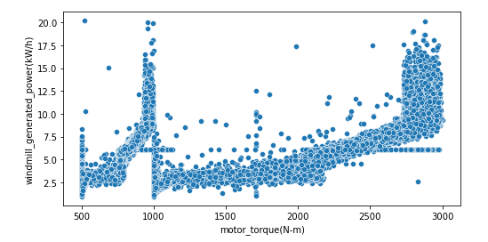
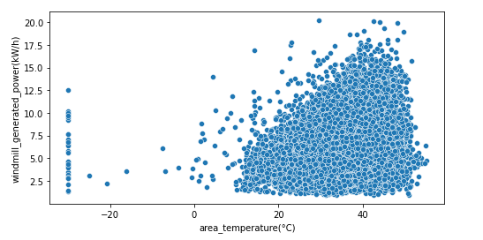
Data Visualization:

Slide 13
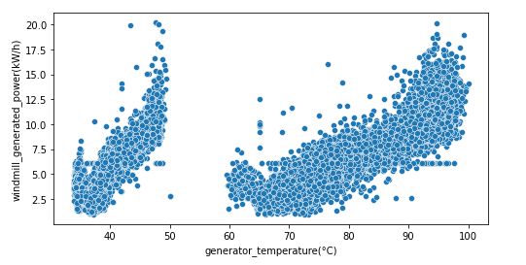
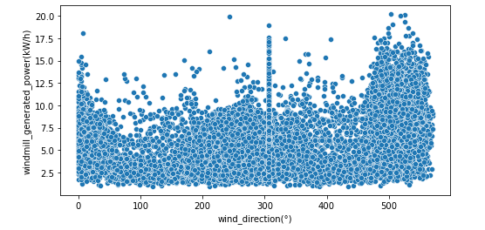

Slide 14
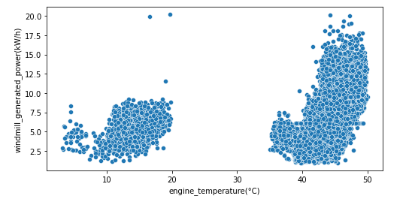
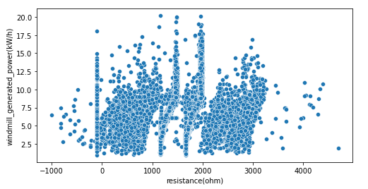

Slide 15
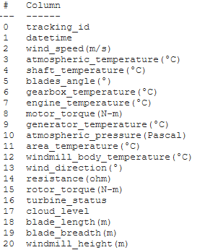
Preprocessing the test dataset:
The test dataset has the following 22 features.
Out of 21 features 18 features(excluding datetime ,
tracking_id , atmospheric pressure(Pascal) columns)
are used for testing to predict the power generated by the windmill.

Slide 16
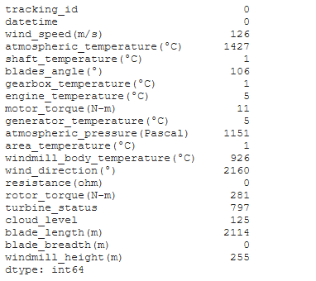
Handling Null Values:
The test dataset has null values in the columns . The number of null values
is given below.
There are two types of null values.
Numerical null values.
Categorical null values.
Numerical null value of a specific
column are replaced with the mean
of that specific column.
Categorical null value of a specific
column are replaced with the mode
value of that specific column.

Slide 17
Feature Engineering:
Since the algorithm requires numeric dataframe only,the columns of object type (i.e.,cloud_level,turbine_status columns) has been changed to numeric by applying dummies to the unique values of those columns.
This has increased the number of columns from 21 columns to 36 columns.
The tracking_id and datetime column in the dataset are dropped since it
has no effect while predicting.
The atmospheric_temperature(°C) column is dropped.

Slide 18
Model creation:
First, the train dataset is used to train and test. The dataset is sliced into two parts train and test.
The two parts are further divided int0 train and test dataframes using train_test_split function from model_selection module in sklearn library taking the test size as 20% of the train dataset(i.e.,xtrain,ytrain,xtest,ytest)
The model has been trained using train data that has been allocated(i.e,80% of train dataset) using XGBRegressor learning algorithm
The prediction is made for xtest using predict method.
For accuracy ,r2_score function is used from metrics which has given a r2_score of 0.9453446432927175

Slide 19
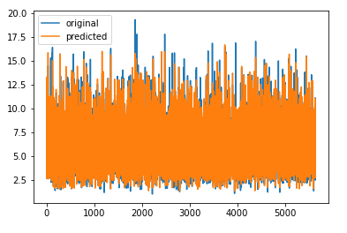
Accuracy plot:

Slide 20
Code:
import pandas as pd
import numpy as np
import matplotlib.pyplot as plt
import seaborn as sns
from xgboost import XGBRegressor
from sklearn.metrics import r2_score
train = pd.read_csv("wind_train.csv")
test = pd.read_csv("wind_test.csv")
train.head()
train.shape
train.info()
train.describe()
#Handling NaN Values
train.isnull().sum()
sns.heatmap(train.isnull(),yticklabels=False,cbar=False,cmap="viridis")

Slide 21
train = train.fillna({ "wind_speed(m/s)" : train["wind_speed(m/s)"].mean(), "atmospheric_temperature(°C)" : train["atmospheric_temperature(°C)"].mean(), "shaft_temperature(°C)" : train["shaft_temperature(°C)"].mean(), "blades_angle(°)" : train["blades_angle(°)"].mean(), "gearbox_temperature(°C)" : train["gearbox_temperature(°C)"].mean(), "engine_temperature(°C)" : train["engine_temperature(°C)"].mean(), "motor_torque(N-m)" : train["motor_torque(N-m)"].mean(), "generator_temperature(°C)" : train["generator_temperature(°C)"].mean(), "atmospheric_pressure(Pascal)" : train["atmospheric_pressure(Pascal)"].mean(), "area_temperature(°C)" : train["area_temperature(°C)"].mean(), "windmill_body_temperature(°C)" : train["windmill_body_temperature(°C)"].mean(), "wind_direction(°)" : train["wind_direction(°)"].mean(), "resistance(ohm)" : train["resistance(ohm)"].mean(), "rotor_torque(N-m)" : train["rotor_torque(N-m)"].mean(), "blade_length(m)" : train["blade_length(m)"].mean(), "blade_breadth(m)" : train["blade_breadth(m)"].mean(), "windmill_height(m)" : train["windmill_height(m)"].mean(), "windmill_generated_power(kW/h)" : train["windmill_generated_power(kW/h)"].mean() })
sns.heatmap(train.isnull(),yticklabels=False,cbar=False,cmap="viridis")
train["cloud_level"].value_counts().plot.bar()
plt.show()
train["turbine_status"].value_counts().plot.bar()
plt.show()
train["turbine_status"].mode()
train["cloud_level"].fillna("Low",inplace=True)
train["turbine_status"].fillna("BB",inplace=True)
sns.heatmap(train.isnull(),yticklabels=False,cbar=False,cmap="viridis")
train = pd.get_dummies(data=train,columns=["cloud_level","turbine_status"])
train.head()
#Data Visualization
train.dtypes
col = [ 'wind_speed(m/s)','atmospheric_temperature(°C)', 'shaft_temperature(°C)', 'blades_angle(°)', 'gearbox_temperature(°C)', 'engine_temperature(°C)', 'motor_torque(N-m)', 'generator_temperature(°C)', 'atmospheric_pressure(Pascal)', 'area_temperature(°C)', 'windmill_body_temperature(°C)', 'wind_direction(°)', 'resistance(ohm)', 'rotor_torque(N-m)', 'blade_length(m)', 'blade_breadth(m)', 'windmill_height(m)’]

Slide 22
for i in col:
plt.figure(figsize=(8,4))
sns.scatterplot(data=train, x=i, y='windmill_generated_power(kW/h)’)
train[train.columns[2:]].corr()['windmill_generated_power(kW/h)'][:]
train.drop(["atmospheric_temperature(°C)"],axis=1,inplace=True)
#Preprocessing the test dataset
test.head()
print(test.shape)
test.info()
#Handling NaN values
test.isnull().sum()
sns.heatmap(test.isnull(),yticklabels=False,cbar=False,cmap="viridis")
test = test.fillna({
"wind_speed(m/s)" : test["wind_speed(m/s)"].mean(),
"atmospheric_temperature(°C)" : test["atmospheric_temperature(°C)"].mean(),
"shaft_temperature(°C)" : test["shaft_temperature(°C)"].mean(),
"blades_angle(°)" : test["blades_angle(°)"].mean(),
"gearbox_temperature(°C)" : test["gearbox_temperature(°C)"].mean(),
"engine_temperature(°C)" : test["engine_temperature(°C)"].mean(),
"motor_torque(N-m)" : test["motor_torque(N-m)"].mean(),
"generator_temperature(°C)" : test["generator_temperature(°C)"].mean(),
"atmospheric_pressure(Pascal)" : test["atmospheric_pressure(Pascal)"].mean(),
"area_temperature(°C)" : test["area_temperature(°C)"].mean(),
"windmill_body_temperature(°C)" : train["windmill_body_temperature(°C)"].mean(),
"wind_direction(°)" : test["wind_direction(°)"].mean(),
"rotor_torque(N-m)" : test["rotor_torque(N-m)"].mean(),
"blade_length(m)" : test["blade_length(m)"].mean(),
"windmill_height(m)" : test["windmill_height(m)"].mean(),
})
sns.heatmap(test.isnull(),yticklabels=False,cbar=False,cmap="viridis")
#Handling categorial NaN values
test["cloud_level"].value_counts().plot.bar()
plt.show()
test["turbine_status"].value_counts().plot.bar()
plt.show()

Slide 23
print(test["cloud_level"].mode())
print(test["turbine_status"].mode())
test["cloud_level"].fillna("Low",inplace=True)
test["turbine_status"].fillna("BB",inplace=True)
sns.heatmap(test.isnull(),yticklabels=False,cbar=False,cmap="viridis")
test = pd.get_dummies(data=test,columns=["cloud_level","turbine_status"])
test.head()
test.head()
test.dtypes
#Creating a model
print(train.shape)
train.head()
print(test.shape)
test.head()
test.drop(["atmospheric_temperature(°C)","tracking_id","datetime"],axis=1,inplace=True)
x = train.drop(["windmill_generated_power(kW/h)","tracking_id","datetime"],axis=1)
y = train["windmill_generated_power(kW/h)"]
from sklearn.model_selection import train_test_split
xtrain,xtest,ytrain,ytest = train_test_split(x,y,test_size=0.2,random_state=0)
xgb = XGBRegressor()
xgb.fit(xtrain,ytrain)
y_train_pred = xgb.predict(xtrain)
y_test_pred = xgb.predict(xtest)
print(r2_score(ytrain,y_train_pred))
print(r2_score(ytest,y_test_pred))
length = range(len(ytest))
plt.plot(length,ytest,label="original")
plt.plot(length,y_test_pred,label="predicted")
plt.legend()
plt.show()
pred = xgb.predict(test)
pred

Slide 24
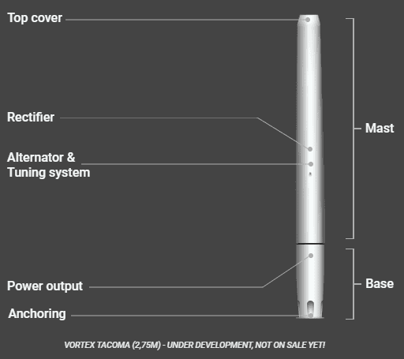
Future Developments: Vortex bladeless
The project of Re-inventing wind turbines which does not use any blades for power generation is in progress by a Spanish company vortex bladeless.
Vortex technology uses no blades ,getting energy from wind through oscillation without gears , brakes nor oil . Its design makes it a nice alternative for a greener on-site generation
Vortex reduces manufacturing , operation and maintenance
cost drastically and harmless to wildlife.
Reference:Vortex Bladeless Turbine - Reinventing wind energy!

Slide 25
Tools Used:
Jupyter Notebook
Pandas,Numpy,Seaborn and Matplotlib,sklearn
References:
Refer kaggle link for train and test dataset: Link

